Slide 1
Project Presentation
Combined cnn-rnn architecture for stock market analysis
Supervisor : R. Venkatesan
Prepared By : Utkarsh Trivedi
“Vision without implementation is counterproductive.”
- Douglas B. Reeves
ENGI 9861 HPCA – UTKARSH TRIVEDI (201893169) – SLIDE 1/24

Slide 2
Presentation Outline
MOTIVATION - 3
STOCK MARKET OVERVIEW - 4
NEURAL NETWORKS RESEARCH - 5
STOCK MARKET ANALYSIS - 9
IMPLEMENTATION - 11
RESULTS - 19
FUTURE ASPECTS & QUESTIONS - 24
ENGI 9861 HPCA – UTKARSH TRIVEDI (201893169) – SLIDE 2/24

Slide 3

Motivation
PYTHON AUTOMATION
MACHINE LEARNING AND DEEP LEARNING
FINANCIAL ANALYSIS
ENGI 9861 HPCA – UTKARSH TRIVEDI (201893169) – SLIDE 3/24

Slide 4
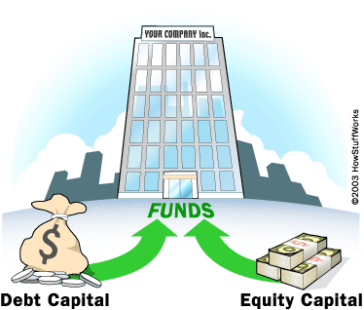

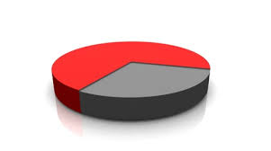


Stock market OVERVIEW
ENGI 9861 HPCA – UTKARSH TRIVEDI (201893169) – SLIDE 4/24

Slide 5
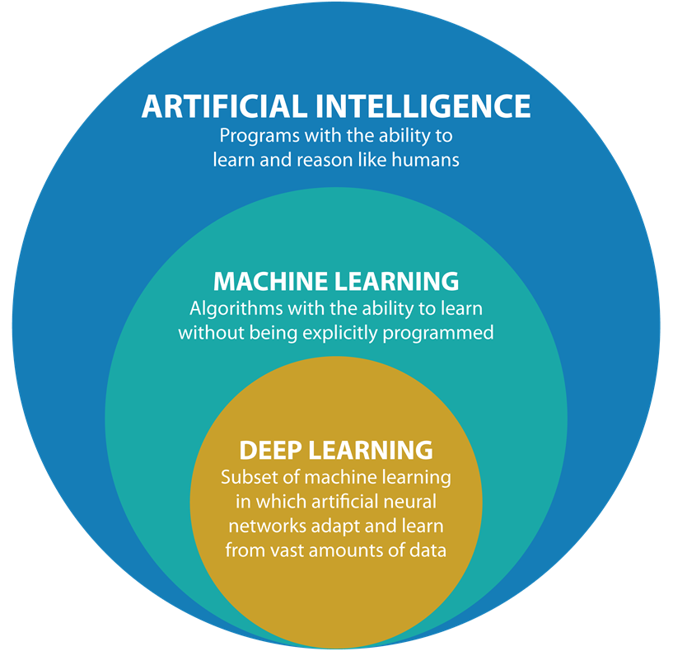
NEURAL NETWORKS research
[1] Deep learning in neural networks: An overview - J Schmidhuber - Neural networks, 2015 - Elsevier
ENGI 9861 HPCA – UTKARSH TRIVEDI (201893169) – SLIDE 5/24

Slide 6

Convolutional Neural network (CNN)
Uses: Image and video recognition, Recommender systems, Image classification, Natural language processing (NLP), Medical Image analysis, etc.
[2] Financial Time-Series Data Analysis Using Deep Convolutional Neural Networks – J. Chen, W. Chen, C. Huang, S. Huang, A. Chen – 2016 – IEEE
ENGI 9861 HPCA – UTKARSH TRIVEDI (201893169) – SLIDE 6/24

Slide 7
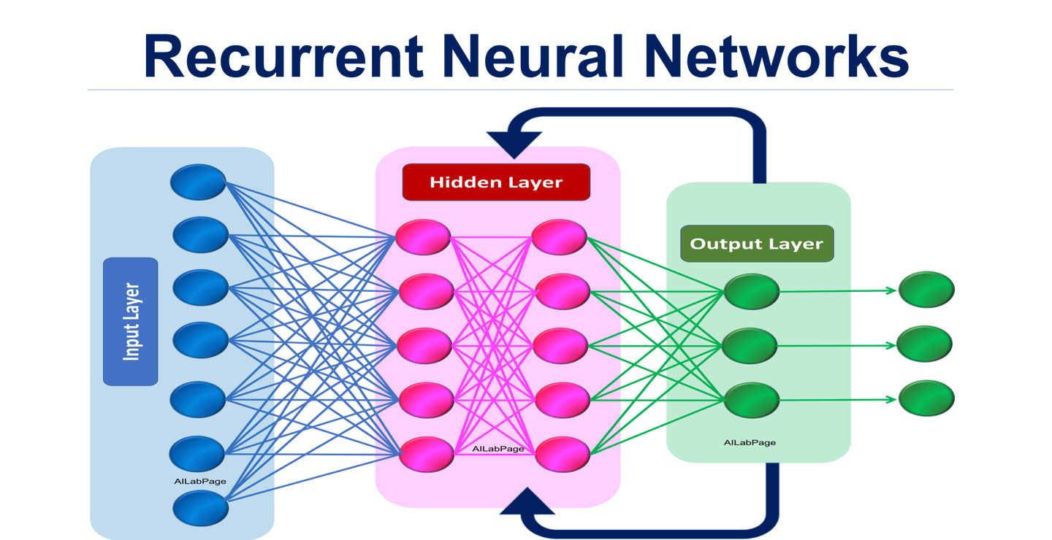
Recurrent Neural network (RNN)
Uses: handwriting recognition, Speech recognition, classification prediction problems, Regression problems, Generative models, etc.
[3] A New Combined CNN-RNN Model for Sector Stock Price Analysis – 2018 – R. Zhang, Z. Yuan, X. Shao - IEEE
ENGI 9861 HPCA – UTKARSH TRIVEDI (201893169) – SLIDE 7/24

Slide 8
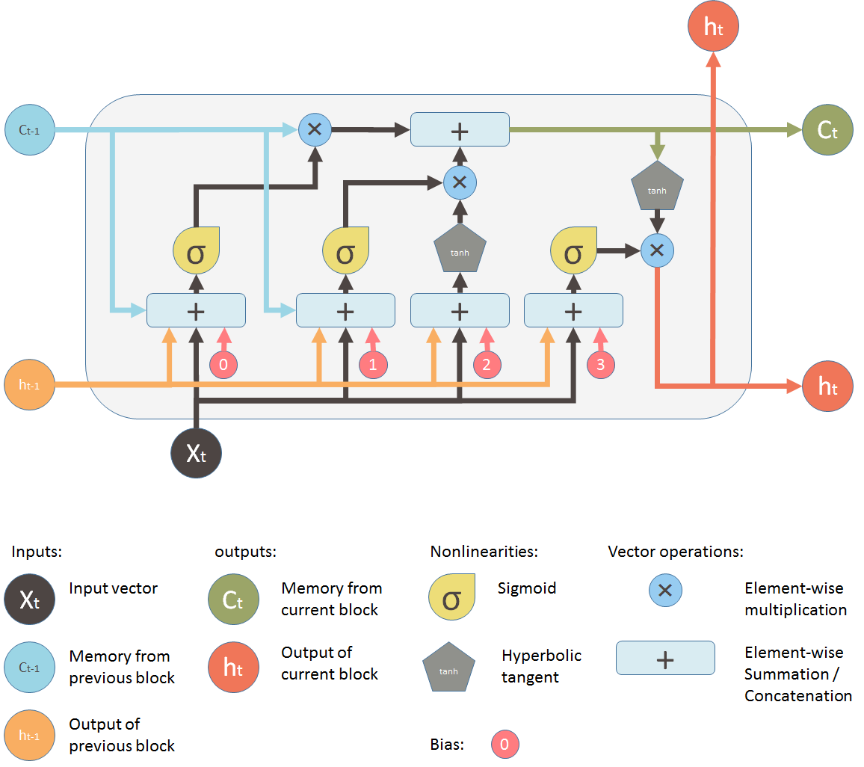
Long short-term memory (lstm)
Uses: translation, sentiment analysis, text generation, time series analysis, traffic anomaly detection, etc.
[4] Development of a Deep Learning-LSTM Trend Prediction Model of Stock Prices – E. Torralba - MSIE 2019
[5] Stock Price Forecasting: New Model for Uptrend Detecting and Downtrend Anticipating Based on Long Short-Term Memory – Y. Touzani, K. Douzi, F. Khoukhi - ICCBDC’18
ENGI 9861 HPCA – UTKARSH TRIVEDI (201893169) – SLIDE 8/24

Slide 9
Stock market analysis
FUNDAMENTAL ANALYSIS: The analysis performed based on the current price of the stock i.e. either it is undervalued or overvalued is fundamental analysis. It is an analysis performed as a long-term strategy. Some of the methods used for fundamental analysis are top-down approach, Bottom-up approach, etc.
TECHNICAL ANALYSIS: The analysis performed based on the historical prices of the stock is done with the help of technical analysis. To perform this analysis various patterns and techniques are used. The ideology used behind this analysis is that a everything significant about the company is already priced into the stock and history of prices and trends tends to repeat itself due to market psychology. Patterns for analysis includes head & shoulders, Cup & saucer, etc. Techniques along with patterns such as exponential moving average, oscillators, support & resistance level etc. are employed. Use of various indicators such as candle sticks is also done for technical analysis as well.
ENGI 9861 HPCA – UTKARSH TRIVEDI (201893169) – SLIDE 9/24

Slide 10
Stock market analysis
3. MACHINE LEARNING: The advancement of various machine learning field has made it a suitable option for the stock market prediction. With so much of data available for processing it is always better to use machine learning for stock market analysis and prediction in this modern century. Use of ANN (artificial neural networks) along with GA (genetic algorithms) is done. Most commonly in ANN’s the feed forward neural network is used for prediction with the backwards propagation of errors algorithm. Other form of ANN’s are time recurrent neural network (RNN) and time delay neural network. The LSTM method which we are applying for the project is part of RNN in deep learning which is subset of machine learning. Hence, as a result of this I have used LSTM model to implement the stock market analysis.
ENGI 9861 HPCA – UTKARSH TRIVEDI (201893169) – SLIDE 10/24

Slide 11
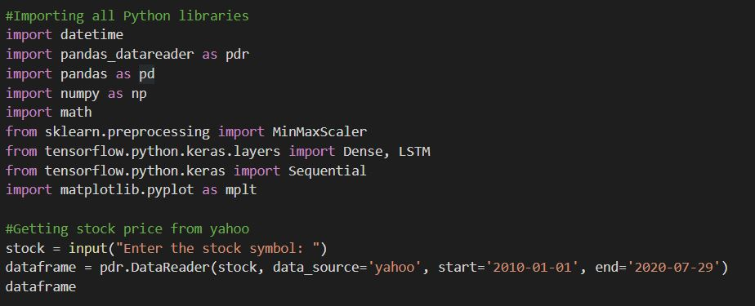
Implementation
ENGI 9861 HPCA – UTKARSH TRIVEDI (201893169) – SLIDE 11/24

Slide 12
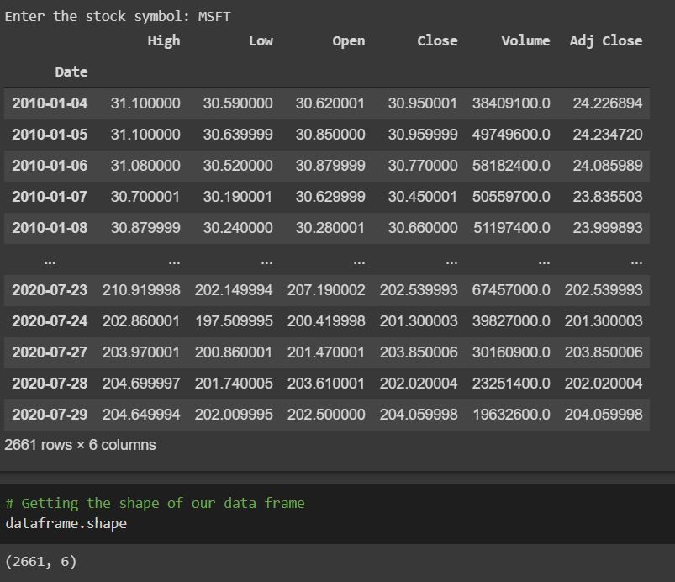
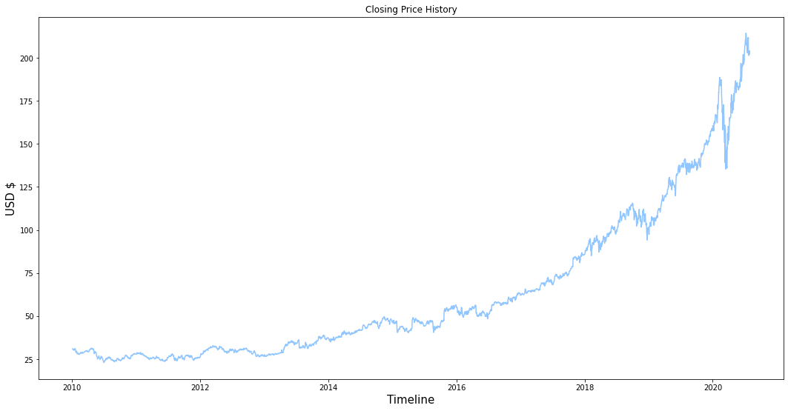
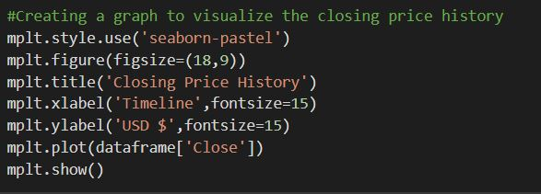
Implementation
ENGI 9861 HPCA – UTKARSH TRIVEDI (201893169) – SLIDE 12/24

Slide 13
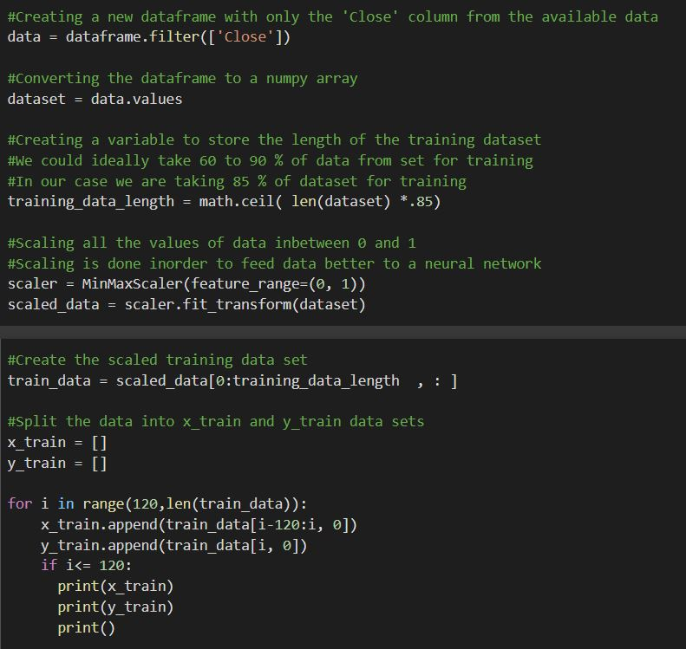
Implementation
ENGI 9861 HPCA – UTKARSH TRIVEDI (201893169) – SLIDE 13/24

Slide 14
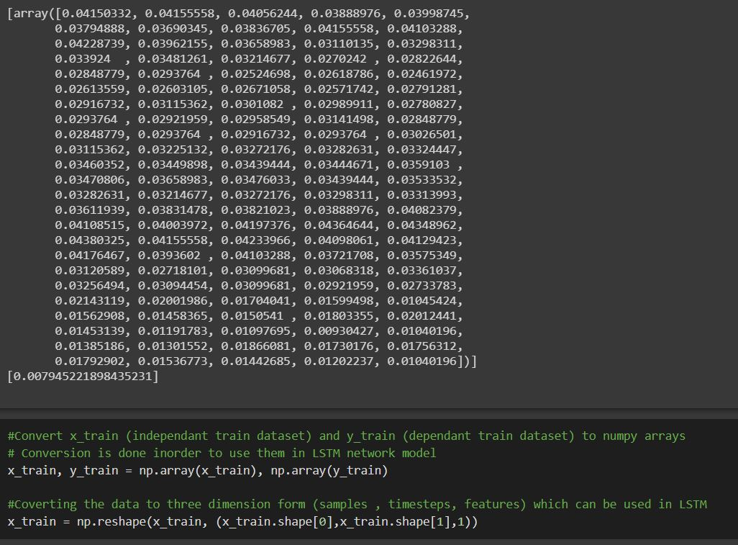
Implementation
ENGI 9861 HPCA – UTKARSH TRIVEDI (201893169) – SLIDE 14/24

Slide 15
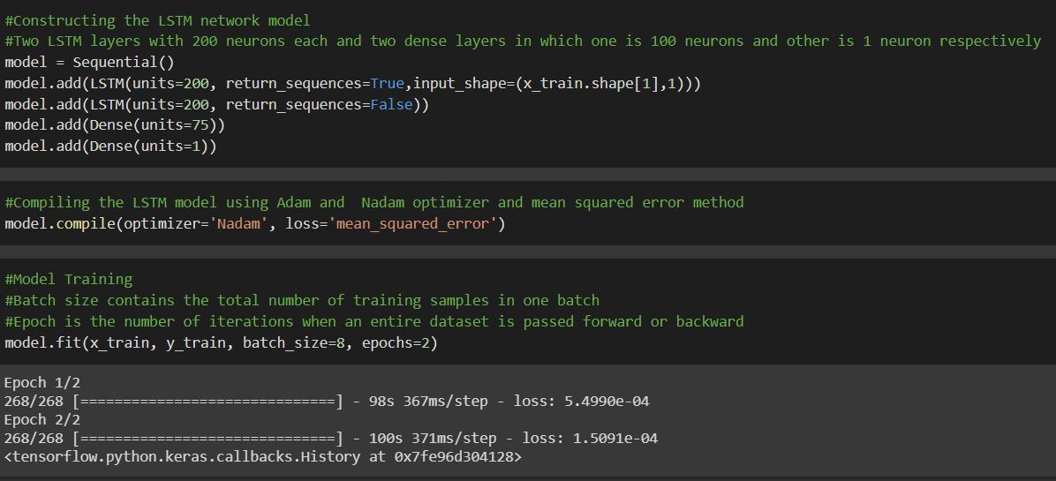
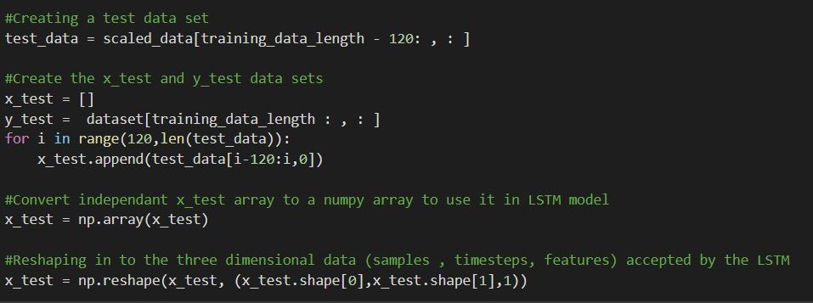
Implementation
ENGI 9861 HPCA – UTKARSH TRIVEDI (201893169) – SLIDE 15/24

Slide 16
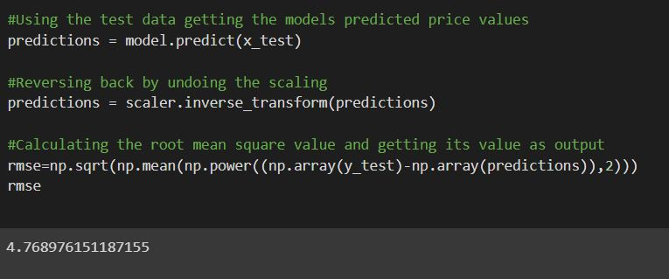
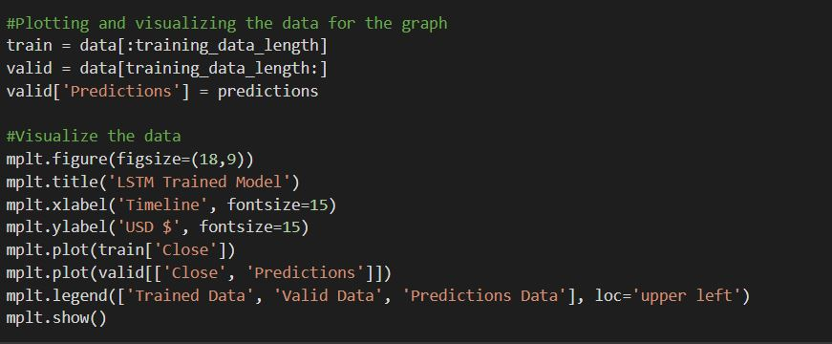
Implementation
ENGI 9861 HPCA – UTKARSH TRIVEDI (201893169) – SLIDE 16/24

Slide 17
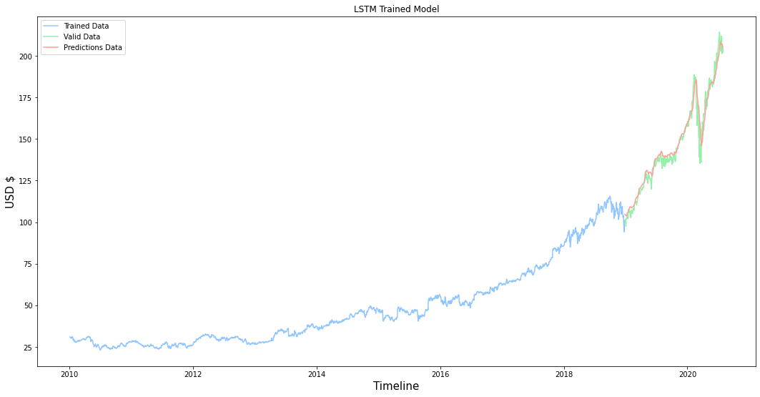
Implementation
ENGI 9861 HPCA – UTKARSH TRIVEDI (201893169) – SLIDE 17/24

Slide 18
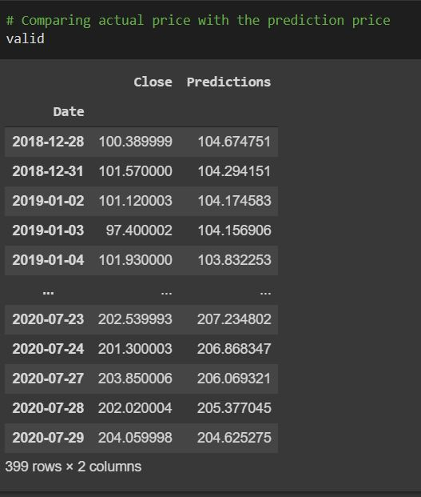
Implementation
ENGI 9861 HPCA – UTKARSH TRIVEDI (201893169) – SLIDE 18/24

Slide 19
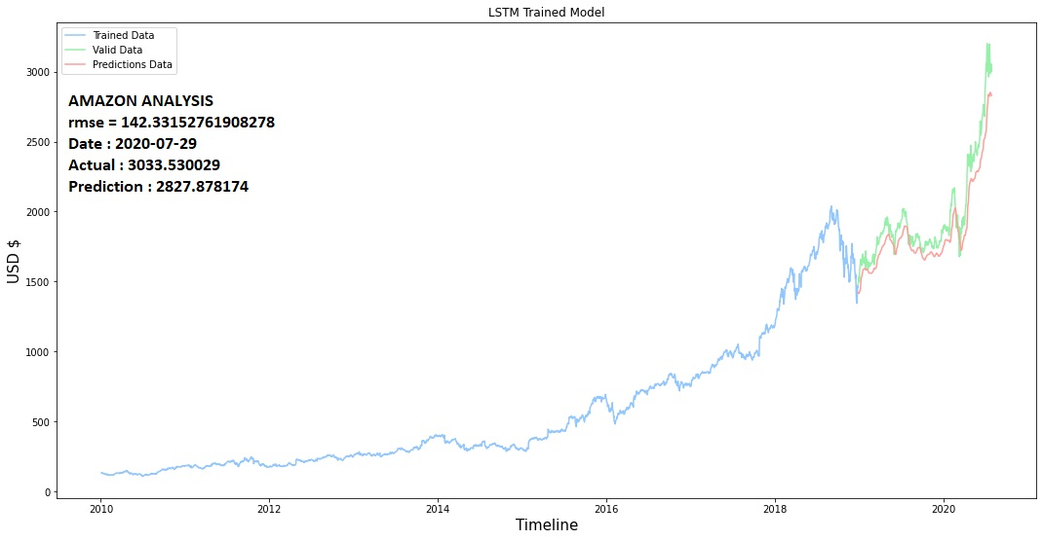
Results
Amazon analysis
ENGI 9861 HPCA – UTKARSH TRIVEDI (201893169) – SLIDE 19/24

Slide 20
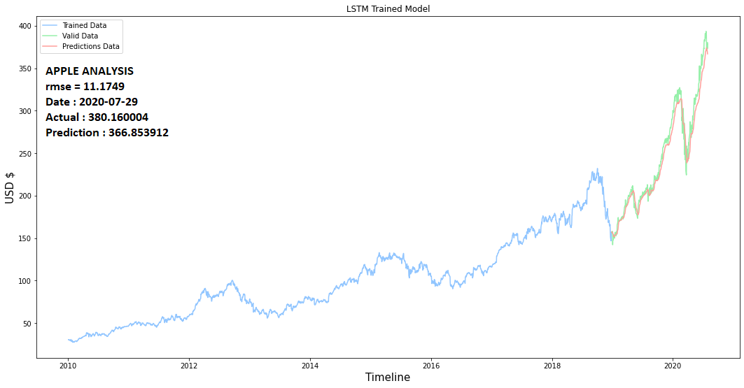
Results
Apple analysis
ENGI 9861 HPCA – UTKARSH TRIVEDI (201893169) – SLIDE 20/24

Slide 21
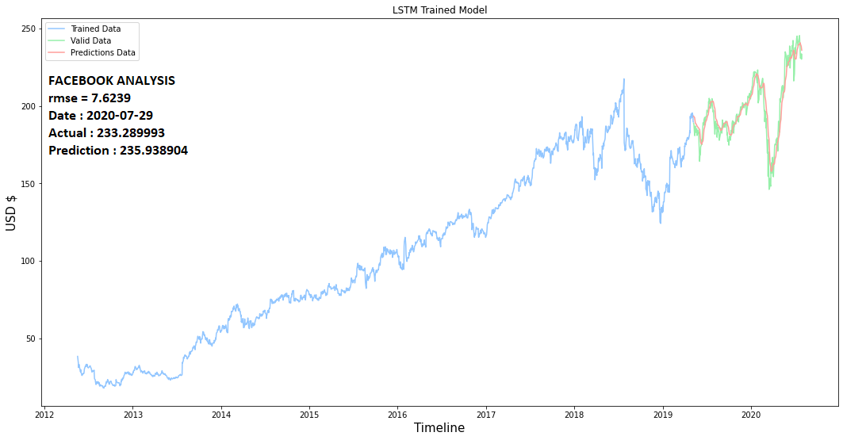
Results
facebook analysis
ENGI 9861 HPCA – UTKARSH TRIVEDI (201893169) – SLIDE 21/24

Slide 22
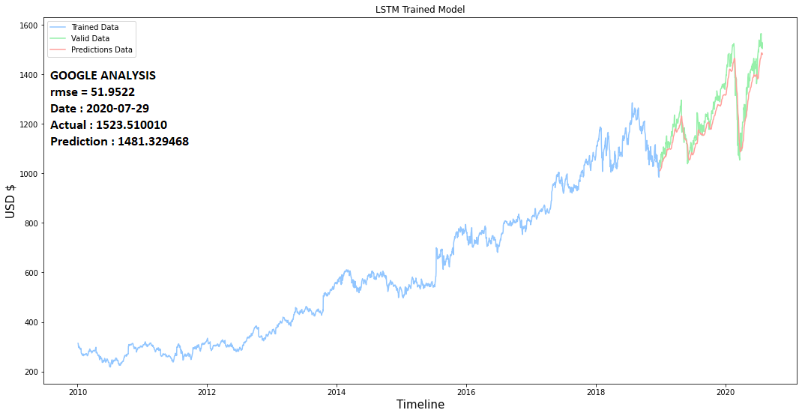
Results
google analysis
ENGI 9861 HPCA – UTKARSH TRIVEDI (201893169) – SLIDE 22/24

Slide 23
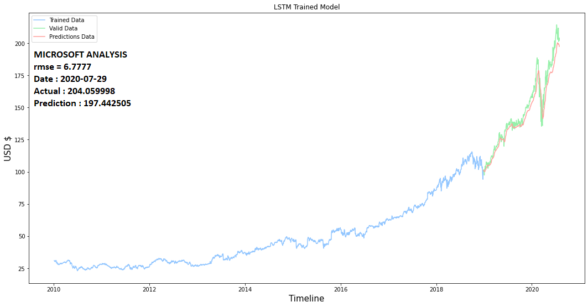
Results
Microsoft analysis
ENGI 9861 HPCA – UTKARSH TRIVEDI (201893169) – SLIDE 23/24

Slide 24
FUTURE ASPECTS
Improve the model’s accuracy as much as possible
Implementing multiple models along with LSTM such as sentimental analysis
Thank you
QUESTIONS ?
ENGI 9861 HPCA – UTKARSH TRIVEDI (201893169) – SLIDE 24/24

